Slide 1
SYNCRONOUS MOTOR PROJECT

Slide 2
STARTING OF MOTOR
The motor is started in induction machine mode.
A resistor is connected across the field windings.
When speed reaches value near synchronous speed, the field winding is connected to the DC voltage .

Slide 3
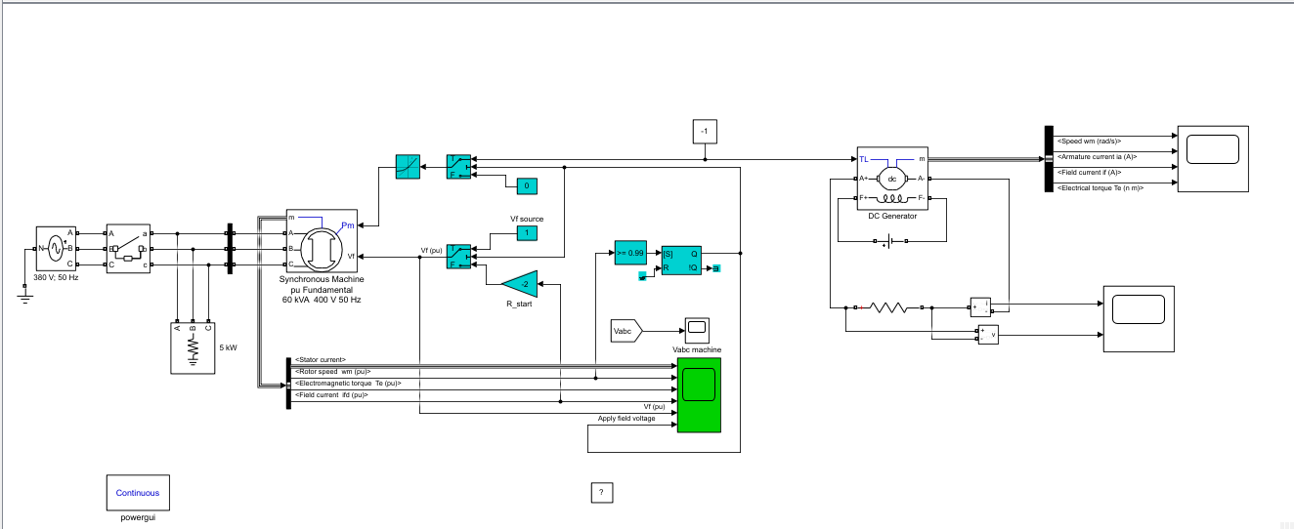
STARTING OF MOTOR (CIRCUIT)

Slide 4
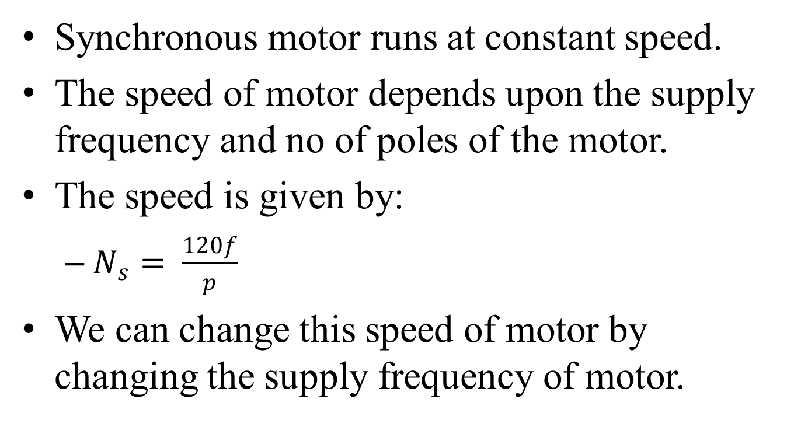
MOTOR SPEED
Synchronous motor runs at constant speed.
The speed of motor depends upon the supply frequency and no of poles of the motor.
The speed is given by:
$N_{s}= \frac{120f}{p}$
We can change this speed of motor by changing the supply frequency of motor.

Slide 5
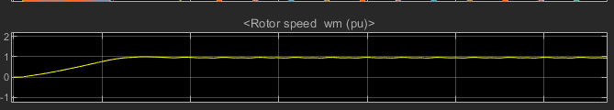
MOTOR SPEED (SIMULATION)
At start, the rotor speed is 0wm and gradually increases to its maximum speed i.e. 1wm and remains constant at 1wm.
However it does fluctuate between 1-0.9wm.

Slide 6
ACTIVE POWER
Power could be controlled by controlling the rotor speed of the machine. Changing the speed would change the power accordingly but since the grid frequency depends upon the speed of the motor, the motor cannot afford to greatly reduce rotor speed. So when very low but active power is required, active power is required by the grid. The rotor speed can be controlled to deliver it.

Slide 7
REACTIVE POWER
When the rotor of synchronous motor is overexcited i.e. given more DC excitation it would provide the needed reactive power to the grid but when the rotor of motor is under-excited i.e. given less DC excitation it would absorb reactive power from the grid. This refers to the reactive power and leading and lagging operation conditions.

Slide 8
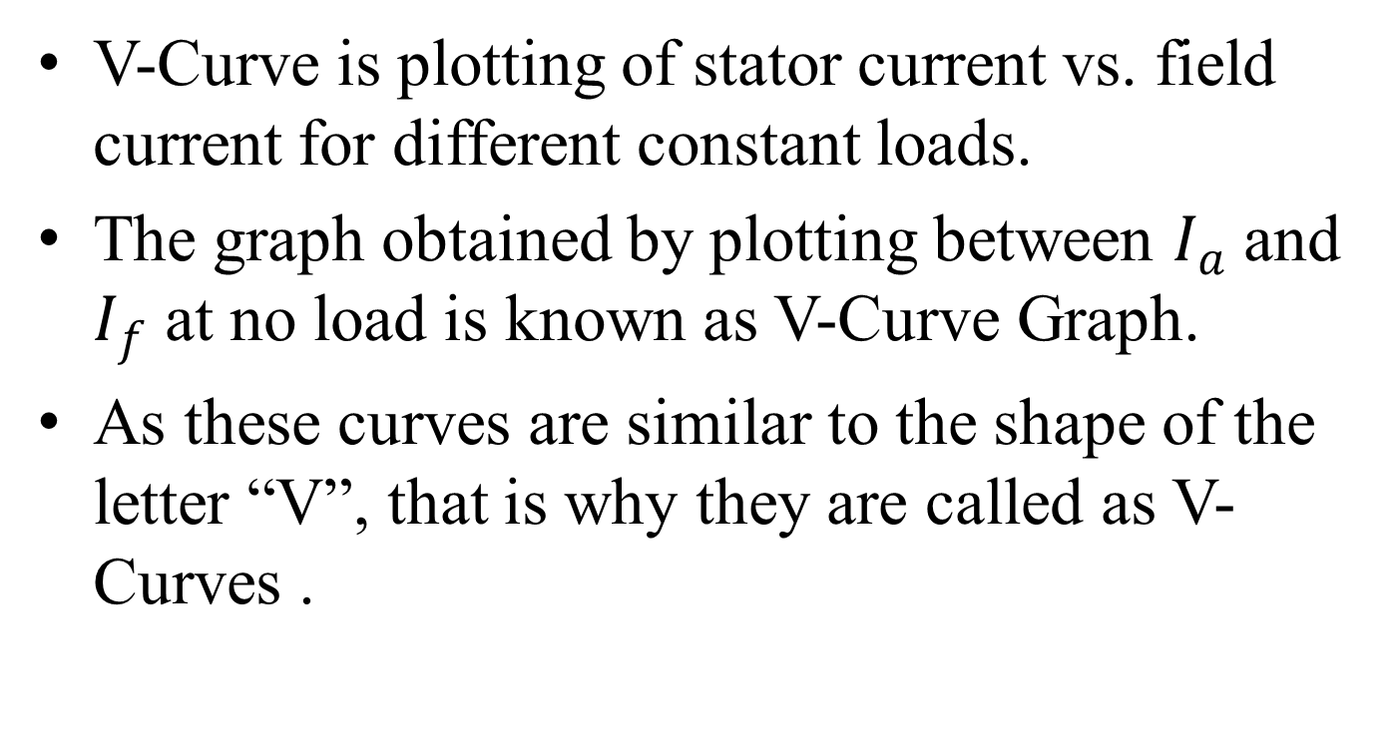
V-CURVES
V-Curve is plotting of stator current vs. field current for different constant loads.
The graph obtained by plotting between $I_{a}$ and $I_{f}$ at no load is known as V-Curve Graph.
As these curves are similar to the shape of the letter “V”, that is why they are called as V-Curves .

Slide 9
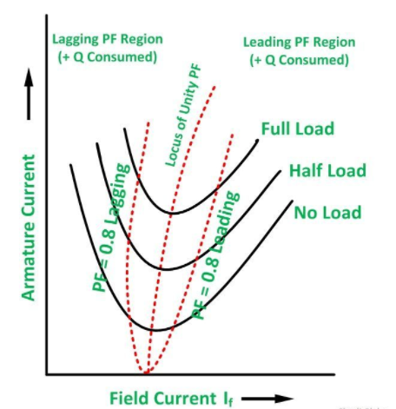
V-CURVES (GRAPH)
The curve connecting all the lowest points of all V-Curves for different power levels is called Unity Power Factor Compounding Curve. The compounding curves for 0.8 power factor lagging and 0.8 power factor leading are shown in the figure above by the red dotted line.

Slide 10
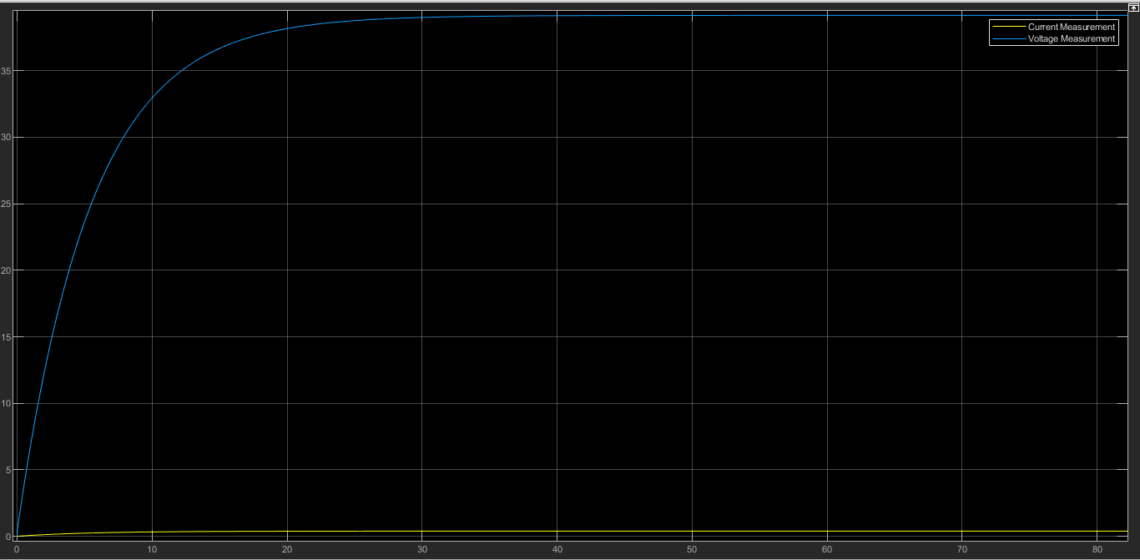
TERMINAL VOLTAGES (GRAPH)
The voltage across the terminals is zero. As the speed of motor increases the voltage also increases. As soon as the speed of motor becomes constant, the voltage also becomes a constant straight line parallel to X-Axis at approx. 39 Volts. The blue line in the graph indicates the voltage across the terminals.

Slide 11
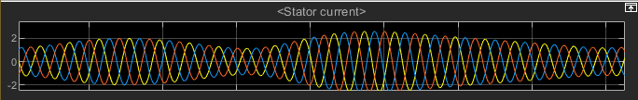
STATOR CURRENT (GRAPH)
The stator current fluctuates from min i.e. 1,0,-1 and 2,0,-2 Amperes, to max i.e. 2.5,0,-2.5 Amperes. This fluctuation continues from min to max values synchronously.

Slide 12
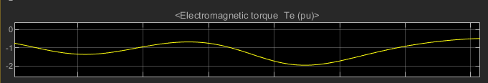
OUTPUT TORQUE (GRAPH)
The torque value fluctuates between -0.8 to -1.3 Te and it also does decreases to -2 Te. This fluctuation continues throughout in a constant manner as this torque is produced by the synchronous motor.

Slide 13
POWER FACTOR
Synchronous motors are designed to operate at 1.0 power factor or 0.8 power factor i.e. unity and leading power factor respectively. By varying the DC excitation of the motor, the power factor of the motor can be varied widely. Over excited synchronous motors operate at leading power factor and provide kVAR-like capacitors. This yields an improved power factor for the power supply system.

Slide 14
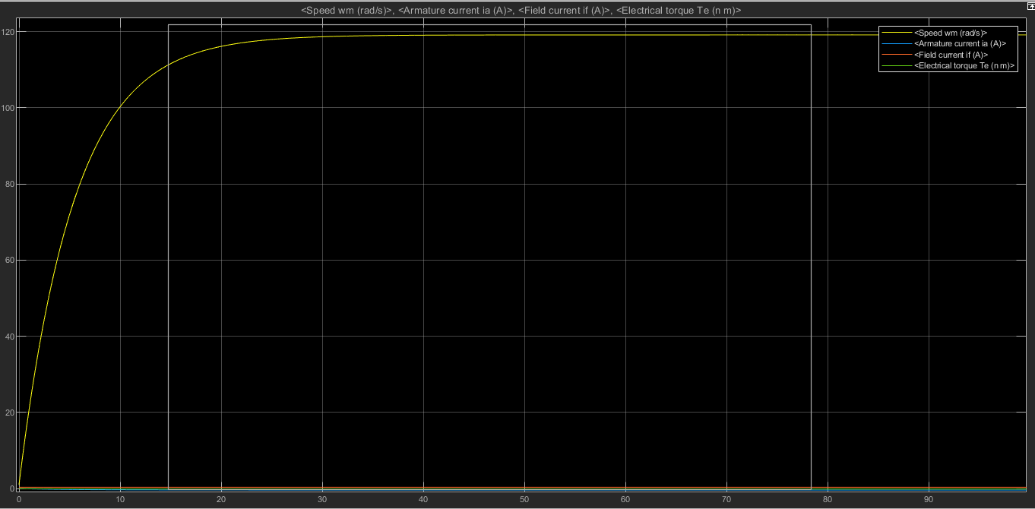
DC GENERATOR (GRAPHS)
The graphs shows that the speed of rotor of DC generator increases with the rotor of synchronous motor and produces constant current, voltage and torque.

Slide 15
CONCLUSION
Synchronous motor is one of the most efficient motors.
The ability to control their power factor makes it very demandable especially for low speed drives.
Speed remains constant irrespective of the loads in synchronous motors.
Electro-magnetic power varies linearly with the voltage in synchronous motors.

